Slide 1
CASE Tools and their Effect on
Software Quality

Slide 2
Introduction
There are lots of automated tools to assist in software engineering.
Their purpose is to make the work of software development and maintenance easier and more reliable.
CASE is Computer Aided Software Engineering.

Slide 3
Introduction
Case tools offer us
Substantial savings in resources required for software development
  Shorter time to market
  Substantial savings in resources for maintenance
  Greater reuse due to increased standardization of the software systems, and
  Reduced generation of defects coupled with increased ‘interactive’ identification of defects during development
It is the last one that is most concerned with SQA.

Slide 4
CASE and its Contributions
What is a CASE tool?
The contribution of CASE tools to software product quality
The contribution of CASE tools to software maintenance quality

Slide 5
CASE Tools - Definition
CASE tools are computerized software development tools that support the developer when performing one or more phases of the software life cycle and/or support software maintenance.

Slide 6
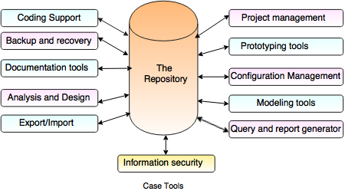

Slide 7
CASE Tools
Must distinguish between ‘classic’ case tools and ‘real’ case tools.
Classic CASE tools: Interactive debuggers, compilers, project progress control systems
Real Case tools: support several phases of development.

Slide 8
Components of CASE Tools
Central Repository - CASE tools require a central repository, which can serve as a source of common, integrated and consistent information. Central repository is a central place of storage where product specifications, requirement documents, related reports and diagrams, other useful information regarding management is stored. Central repository also serves as data dictionary.
Upper Case Tools - Upper CASE tools are used in planning, analysis and design stages of SDLC.
Lower Case Tools - Lower CASE tools are used in implementation, testing and maintenance.
Integrated Case Tools - Integrated CASE tools are helpful in all the stages of SDLC, from Requirement gathering to Testing and documentation.
CASE tools can be grouped together if they have similar functionality, process activities and capability of getting integrated with other tools.

Slide 9
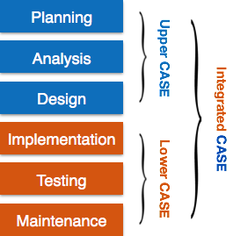
Software CASE tools Overview

Slide 10
CASE Tools
The main component of real CASE tools is the repository!
  Example: Rational Team Concert (RTC)
Repository stores all changes and info related to the project from development through maintenance.
Maintenance:
  Corrective
  Preventive
  Adaptive
  Perfective(Functional improvements).
There is a computerized management of the repository!
The repository is the glue holding all activities together.

Slide 11
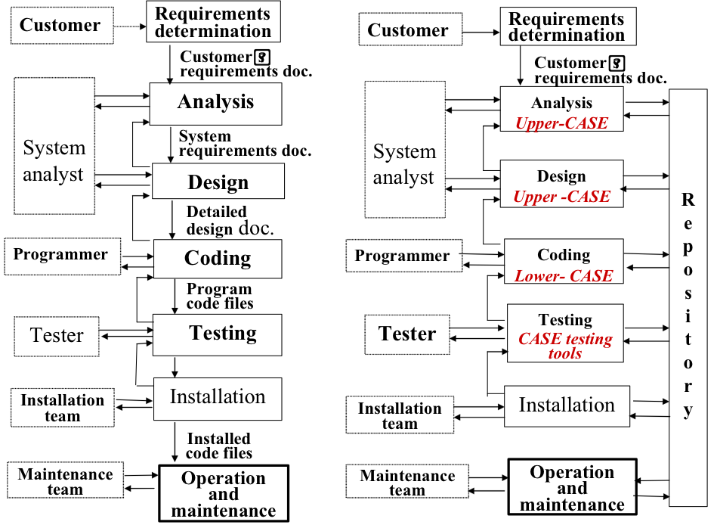
Can see comparisons and real CASE tool supports.
Note the Repository; Note the xxx-CASE tools.
Traditional development life cycle
Real CASE tool-supported development life cycle

Slide 12
CASE Tools
Some CASE tools will automatically generate code from designs stored in the repository.
  Example: Rational Rose and others; often based on a design model and parameters supplied….
Some CASE tools provide for ‘reverse engineering’
  These are used to recover and/or replicate design documents from running, well-established (legacy) software systems.
  These tools may create completed updated repository and design documents based on the code.

Slide 13
CASE Tool Support
Type of CASE tool
Support Provided
Editing and Diagramming
Repository Query
Automated Documentation
Design Support
Editing text and diagrams, generating design diagrams to repository records
Display of parts of the design texts, charts, etc.; cross referencing queries and requirements tracing
Automatic generation of requested documentation according to updated repository records
Editing design recorded by the systems analyst and management of the data dictionary

Slide 14
CASE Tool Support
Type of CASE tool
Support Provided
Code Editing
Code Generation
Configuration Management
Compiling, interpreting or applying interactive debugging code specific coding language or development tool
Transformation of design records into prototypes or application software compatible with a given software development language (or development tools)
Management of design documents and software code versions, control of changes and software code.

Slide 15
CASE Tool Support
Type of CASE tool
Support Provided
Reverse Engineering (re-engineering)
Project Management and Software Metrics
Construction of a software repository and design documents, based on code: the “legacy” software systems. Once the repository of the legacy software is available, it can be updated and used to automatically generate new versions of the system. As new re-engineering software version is generated, it can be easily maintained and its documentation automatically updated.
Support progress control of software development projects by follow-up of schedules and calculation of productivity and defects metrics

Slide 16

Note that most of the contributions are not addressing faulty requirements definition – (this likely with poor requirements management) are the most frequent causes of software failures.
But most of the contributions are in traceability based on data in the repository and tracing tools.
Great contribution in discovering
  design errors
  coding errors
  testing
  documentation!

Slide 17
Contribution of CASE tools to Software Maintenance Quality
Essentially four kinds of maintenance:
  Corrective
  Preventive
  Adaptive, and
  Perfective(Functional Improvement Maintenance)

Slide 18
Contribution of CASE tools to
Software Maintenance Quality
Corrective Maintenance: (Errors)
* CASE-generated updated documentation enables easier and more reliable identification of software failure causes.
* Cross-referenced queries enable better anticipation effects of proposed correction.
* Correction by means of lower CASE or integrated CASE tools provides automated coding and documentation of corrections.
Preventive maintenance:
This type of maintenance includes modifications and updations to prevent future problems of the software. It goals to attend problems, which are not significant at this moment but may cause serious issues in future

Slide 19
Contribution of CASE tools to
Software Maintenance Quality
To adaptive maintenance:
Full and updated documentation by CASE tools enables thorough examination of possible software adaptations for new applications.
This includes modifications and updations when the customers need the product to run on new platforms, on new operating systems, or when they need the product to interface with new hardware and software.
Perfective maintenance:
A software product needs maintenance to support the new features that the users want or to change different types of functionalities of the system according to the customer demands.

